Slide 1

TEAM 19: PATRICIA LUIS, SUZELLE MEJIA, CHARLES MO

Slide 2
TEAM 19: PATRICIA LUIS, SUZELLE MEJIA, CHARLES MO

Slide 3

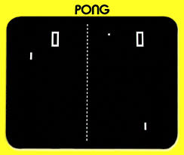
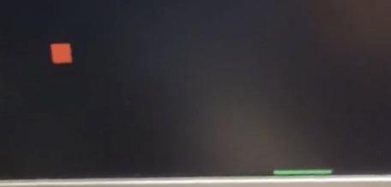
GOAL / MOTIVATION
To replicate the arcade game of Pong
Single player, but stores the highest score so players can still compete with their friends
The real life use of this is mainly entertainment

Slide 4
FUNCTIONALITY
We are creating a single player pong game in which the buttons on the FPGA board slide a paddle across the bottom of the screen to catch a ball.
As time progresses the ball gets faster to make it more challenging.
Additionally, the current score is displayed on the 7-segment display, and the highest score is saved and also available to display on the 7-segment display.

Slide 5
SPECIFICATION
Requirements:
Needed to use the VGA display as a screen to view the game
Use buttons to move the paddle left and right and have a button that starts the game
Have a collision detector that senses when the ball hits the paddle
Keep track of the score
Constraints:
How quickly we could make the ball go for the game to remain functional.
Making the ball a circle.

Slide 6
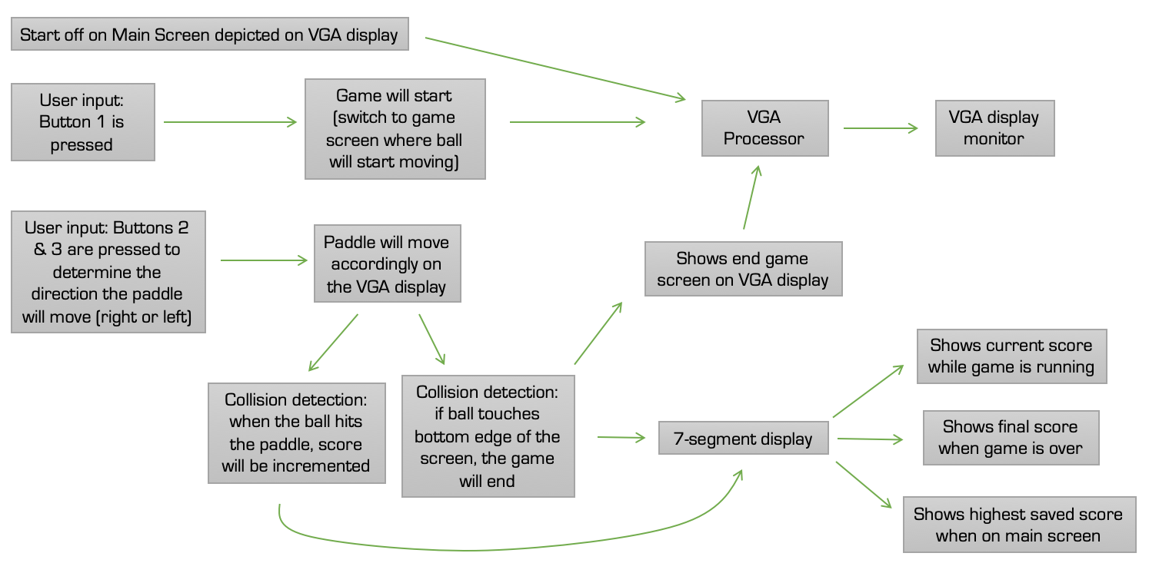
BLOCK DIAGRAM

Slide 7
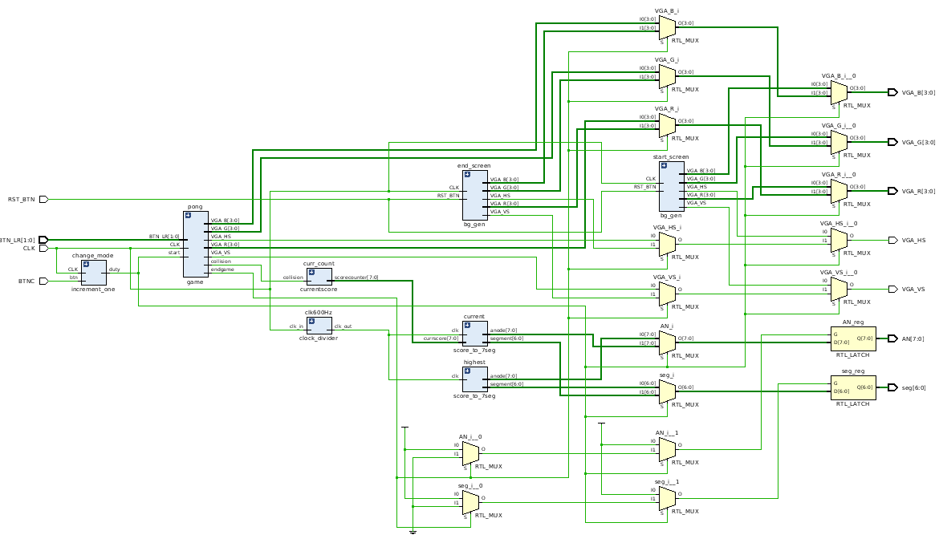
BLOCK DIAGRAM

Slide 8
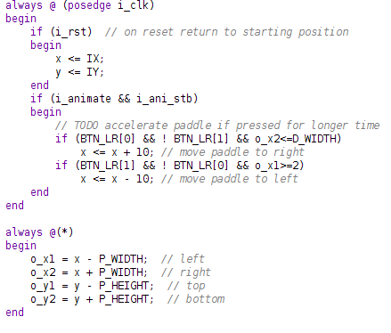
CODE SNIPPET #1 :
Buttons to move the paddle left and right

Slide 9
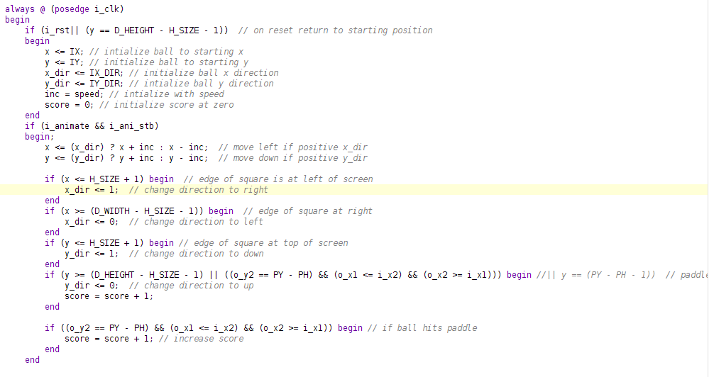
CODE SNIPPET #2 : Collision detection

Slide 10
SIMULATION
ULTIMATE PONG DEMO

Slide 11
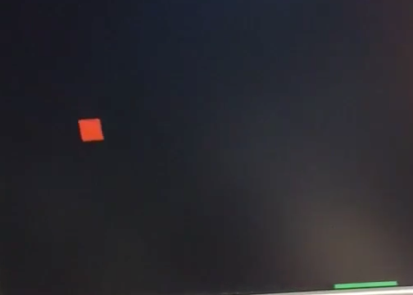
SUCCESSES
The collision detection.
The ball and paddle size are realistic and proportional.
It saves the highest score and displays.
Displays current score while playing on 7-seg.

Slide 12
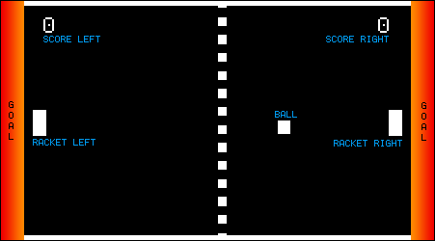
FAILURES
Display the current score on the VGA as you play.
When the speed increments it causes issues with detection.
The ball isn’t a circle, and we could’ve made the paddle more realistic

Slide 13
Thanks!

Slide 14
GOAL / MOTIVATION
To replicate the arcade game of Pong
Single player, but stores the highest score so players can still compete with their friends
The real life use of this is mainly entertainment

Slide 15
FUNCTIONALITY
We are creating a single player pong game in which the buttons on the FPGA board slide a paddle across the bottom of the screen to catch a ball.
As time progresses the ball gets faster to make it more challenging.
Additionally, the current score is displayed on the 7-segment display, and the highest score is saved and also available to display on the 7-segment display.

Slide 16
SPECIFICATION
Requirements:
Needed to use the VGA display as a screen to view the game
Use buttons to move the paddle left and right and have a button that starts the game
Have a collision detector that senses when the ball hits the paddle
Keep track of the score
Constraints:
How quickly we could make the ball go for the game to remain functional.
Making the ball a circle.

Slide 17
BLOCK DIAGRAM

Slide 18
BLOCK DIAGRAM

Slide 19
CODE SNIPPET #1 :
Buttons to move the paddle left and right

Slide 20
CODE SNIPPET #2 : Collision detection

Slide 21
SIMULATION
ULTIMATE PONG DEMO

Slide 22
SUCCESSES
The collision detection.
The ball and paddle size are realistic and proportional.
It saves the highest score and displays.
Displays current score while playing on 7-seg.

Slide 23
FAILURES
Display the current score on the VGA as you play.
When the speed increments it causes issues with detection.
The ball isn’t a circle, and we could’ve made the paddle more realistic

Slide 24
Thanks!

